Slide 1
Interaction terms

Slide 2
When do we use interaction terms?
Do our theories/expectations have scope conditions?
Do our theories imply conditional relationships?

Slide 3
A Simple Example
Is there a gender gap in income?
Do correlates of income differ for men and women?
  Parenting penalizes women more than men
  Education helps women more than men (or perhaps men have a higher floor)
If I have survey data on gross personal income (in this case from the Netherlands), how can I test this?

Slide 4
Simple Analysis
DV: Gross income
IV’s: Keeping it simple (probably underspecified)
  Binary gender (0=male, 1=female)
  Number of kids (0-7)
  Education categories (0-5 ordinal scale)
Note: probably endogeneity & selection bias since children are not born at random—but we’re not dealing with that (today)

Slide 5
Simple regression
----------------------------
(1)
gross_in~10k
----------------------------
Female -792.2***
(46.82)
Education 378.1***
(15.92)
N Children -92.06***
(20.60)
_cons 1070.9***
(58.16)
----------------------------
N 5665
----------------------------
Standard errors in parentheses
* p<0.05, ** p<0.01, *** p<0.001
Interpret!

Slide 6
Simple regression
----------------------------
(1)
gross_in~10k
----------------------------
Female -792.2***
(46.82)
Education 378.1***
(15.92)
N Children -92.06***
(20.60)
_cons 1070.9***
(58.16)
----------------------------
N 5665
----------------------------
Standard errors in parentheses
* p<0.05, ** p<0.01, *** p<0.001
On average:
  Women earn less than men, holding education and children constant
  Going to school helps your income, ceteris paribus
  Having kids hurts your income, ceteris paribus

Slide 7
Simple regression
----------------------------
(1)
gross_in~10k
----------------------------
Female -792.2***
(46.82)
Education 378.1***
(15.92)
N Children -92.06***
(20.60)
_cons 1070.9***
(58.16)
----------------------------
N 5665
----------------------------
Standard errors in parentheses
* p<0.05, ** p<0.01, *** p<0.001
Does having more children hurt women’s salary more than men’s?

Slide 8
One Approach: Split the Sample
Men (i.e. “reg Y X if female=0”):
Women (i.e. “reg Y X if female=1”):
-----------------------------
(1)
gross~10k
-----------------------------
Education 429.8***
(23.85)
N Children -25.63
(30.80)
Constant 852.2***
(81.75)
-----------------------------
Observations 3134
-----------------------------
Standard errors in parentheses
* p<0.05, ** p<0.01, *** p<0.001
-----------------------------
(1)
gross~10k
-----------------------------
Education 307.8***
(19.29)
N Children -183.5***
(25.04)
Constant 573.2***
(65.32)
-----------------------------
Observations 2531
-----------------------------
Standard errors in parentheses
* p<0.05, ** p<0.01, *** p<0.001

Slide 9
What are the differences between how much women and men earn?
Men (i.e. “reg Y X if female=0”):
Women (i.e. “reg Y X if female=1”):
-----------------------------
(1)
gross~10k
-----------------------------
Education 429.8***
(23.85)
N Children -25.63
(30.80)
Constant 852.2***
(81.75)
-----------------------------
Observations 3134
-----------------------------
Standard errors in parentheses
* p<0.05, ** p<0.01, *** p<0.001
-----------------------------
(1)
gross~10k
-----------------------------
Education 307.8***
(19.29)
N Children -183.5***
(25.04)
Constant 573.2***
(65.32)
-----------------------------
Observations 2531
-----------------------------
Standard errors in parentheses
* p<0.05, ** p<0.01, *** p<0.001

Slide 10
What are the differences between how much women and men earn?
Men (i.e. “reg Y X if female=0”):
Women (i.e. “reg Y X if female=1”):
-----------------------------
(1)
gross~10k
-----------------------------
Education 429.8***
(23.85)
N Children -25.63
(30.80)
Constant 852.2***
(81.75)
-----------------------------
Observations 3134
-----------------------------
Standard errors in parentheses
* p<0.05, ** p<0.01, *** p<0.001
-----------------------------
(1)
gross~10k
-----------------------------
Education 307.8***
(19.29)
N Children -183.5***
(25.04)
Constant 573.2***
(65.32)
-----------------------------
Observations 2531
-----------------------------
Standard errors in parentheses
* p<0.05, ** p<0.01, *** p<0.001
Both have a positive return to education

Slide 11
What are the differences between how much women and men earn?
Men (i.e. “reg Y X if female=0”):
Women (i.e. “reg Y X if female=1”):
-----------------------------
(1)
gross~10k
-----------------------------
Education 429.8***
(23.85)
N Children -25.63
(30.80)
Constant 852.2***
(81.75)
-----------------------------
Observations 3134
-----------------------------
Standard errors in parentheses
* p<0.05, ** p<0.01, *** p<0.001
-----------------------------
(1)
gross~10k
-----------------------------
Education 307.8***
(19.29)
N Children -183.5***
(25.04)
Constant 573.2***
(65.32)
-----------------------------
Observations 2531
-----------------------------
Standard errors in parentheses
* p<0.05, ** p<0.01, *** p<0.001
Only women pay a penalty for children

Slide 12
What are the differences between how much women and men earn?
Men (i.e. “reg Y X if female=0”):
Women (i.e. “reg Y X if female=1”):
-----------------------------
(1)
gross~10k
-----------------------------
Education 429.8***
(23.85)
N Children -25.63
(30.80)
Constant 852.2***
(81.75)
-----------------------------
Observations 3134
-----------------------------
Standard errors in parentheses
* p<0.05, ** p<0.01, *** p<0.001
-----------------------------
(1)
gross~10k
-----------------------------
Education 307.8***
(19.29)
N Children -183.5***
(25.04)
Constant 573.2***
(65.32)
-----------------------------
Observations 2531
-----------------------------
Standard errors in parentheses
* p<0.05, ** p<0.01, *** p<0.001
When education and children are at their minimum, men out-earn women

Slide 13
What are the differences between how much women and men earn?
Men (i.e. “reg Y X if female=0”):
Women (i.e. “reg Y X if female=1”):
-----------------------------
(1)
gross~10k
-----------------------------
Education 429.8***
(23.85)
N Children -25.63
(30.80)
Constant 852.2***
(81.75)
-----------------------------
Observations 3134
-----------------------------
Standard errors in parentheses
* p<0.05, ** p<0.01, *** p<0.001
-----------------------------
(1)
gross~10k
-----------------------------
Education 307.8***
(19.29)
N Children -183.5***
(25.04)
Constant 573.2***
(65.32)
-----------------------------
Observations 2531
-----------------------------
Standard errors in parentheses
* p<0.05, ** p<0.01, *** p<0.001
BUT is there a significant difference here?

Slide 14
What are the differences between how much women and men earn?
Men (i.e. “reg Y X if female=0”):
Women (i.e. “reg Y X if female=1”):
-----------------------------
(1)
gross~10k
-----------------------------
Education 429.8***
(23.85)
N Children -25.63
(30.80)
Constant 852.2***
(81.75)
-----------------------------
Observations 3134
-----------------------------
Standard errors in parentheses
* p<0.05, ** p<0.01, *** p<0.001
-----------------------------
(1)
gross~10k
-----------------------------
Education 307.8***
(19.29)
N Children -183.5***
(25.04)
Constant 573.2***
(65.32)
-----------------------------
Observations 2531
-----------------------------
Standard errors in parentheses
* p<0.05, ** p<0.01, *** p<0.001
BUT is there a significant difference here?

Slide 15
What are the differences between how much women and men earn?
Men (i.e. “reg Y X if female=0”):
Women (i.e. “reg Y X if female=1”):
-----------------------------
(1)
gross~10k
-----------------------------
Education 429.8***
(23.85)
N Children -25.63
(30.80)
Constant 852.2***
(81.75)
-----------------------------
Observations 3134
-----------------------------
Standard errors in parentheses
* p<0.05, ** p<0.01, *** p<0.001
-----------------------------
(1)
gross~10k
-----------------------------
Education 307.8***
(19.29)
N Children -183.5***
(25.04)
Constant 573.2***
(65.32)
-----------------------------
Observations 2531
-----------------------------
Standard errors in parentheses
* p<0.05, ** p<0.01, *** p<0.001
BUT is there a significant difference here?

Slide 16
How can we test for a significant difference?
Remember, if we are testing if β_{1Male}= β_{1Female}
  Implies we are testing 0= β_{1Male}- β_{1Female}
Calculate the difference
Calculate the standard error
  var(β_{1Male}- β_{1Female})=var(β_{1Male})+var (β_{1Female})
  se(β_{1Male}- β_{1Female})= √[var(β_{1Male})+var (β_{1Female})]
  se(β_{1Male}- β_{1Female})= √[{se(β_{1Male})}² + {se(β_{1Female})}² ]
Calculate the t-statistic

Slide 17
Testing for the effect of children
------------------------------------------
(1) (2)
Men Women
------------------------------------------
Education 429.8*** 307.8***
(23.85) (19.29)
N Children -25.63 -183.5***
(30.80) (25.04)
Constant 852.2*** 573.2***
(81.75) (65.32)
------------------------------------------
Observations 3134 2531
------------------------------------------
Standard errors in parentheses
* p<0.05, ** p<0.01, *** p<0.001
β_{1Male}- β_{1Female}= -25.63-183.5
β_{1Male}- β_{1Female}= 157.87
se(β_{1Male}- β_{1Female})= √[{se(β_{1Male})}² + {se(β_{1Female})}² ]
se(β_{1Male}- β_{1Female})= √[{30.80}² + {se(25.04)}² ]
se(β_{1Male}- β_{1Female})= √1575.642
se(β_{1Male}- β_{1Female})= 39.69
t=3.98

Slide 18
OK-now you guys do the same thing for education and the constant
------------------------------------------
(1) (2)
Men Women
------------------------------------------
Education 429.8*** 307.8***
(23.85) (19.29)
N Children -25.63 -183.5***
(30.80) (25.04)
Constant 852.2*** 573.2***
(81.75) (65.32)
------------------------------------------
Observations 3134 2531
------------------------------------------
Standard errors in parentheses
* p<0.05, ** p<0.01, *** p<0.001
β_{1Male}- β_{1Female}= -25.63-183.5
β_{1Male}- β_{1Female}= 157.87
se(β_{1Male}- β_{1Female})= √[{se(β_{1Male})}² + {se(β_{1Female})}² ]
se(β_{1Male}- β_{1Female})= √[{30.80}² + {se(25.04)}² ]
se(β_{1Male}- β_{1Female})= √1575.642
se(β_{1Male}- β_{1Female})= 39.69
t=3.98

Slide 19
OK-now you guys do the same thing for education and the constant
 | Men | Women | Difference
Education | 429.800*** | 307.800*** | 122.000***
 | (23.850) | (19.290) | (30.675)
N Children | -25.630 | -183.500*** | 157.870***
 | (30.800) | (25.040) | (39.694)
Constant | 852.200*** | 573.200*** | 279.000**
 | (81.750) | (65.320) | (104.641)
Observations | 3134 | 2531
Implications:
  See a gender gap even if have no kids or education

Slide 20
OK-now you guys do the same thing for education and the constant
 | Men | Women | Difference
Education | 429.800*** | 307.800*** | 122.000***
 | (23.850) | (19.290) | (30.675)
N Children | -25.630 | -183.500*** | 157.870***
 | (30.800) | (25.040) | (39.694)
Constant | 852.200*** | 573.200*** | 279.000**
 | (81.750) | (65.320) | (104.641)
Observations | 3134 | 2531
Implications:
  Having kids hurts women more than men

Slide 21
OK-now you guys do the same thing for education and the constant
 | Men | Women | Difference
Education | 429.800*** | 307.800*** | 122.000***
 | (23.850) | (19.290) | (30.675)
N Children | -25.630 | -183.500*** | 157.870***
 | (30.800) | (25.040) | (39.694)
Constant | 852.200*** | 573.200*** | 279.000**
 | (81.750) | (65.320) | (104.641)
Observations | 3134 | 2531
Implications:
  Gaining education helps men more than women

Slide 22
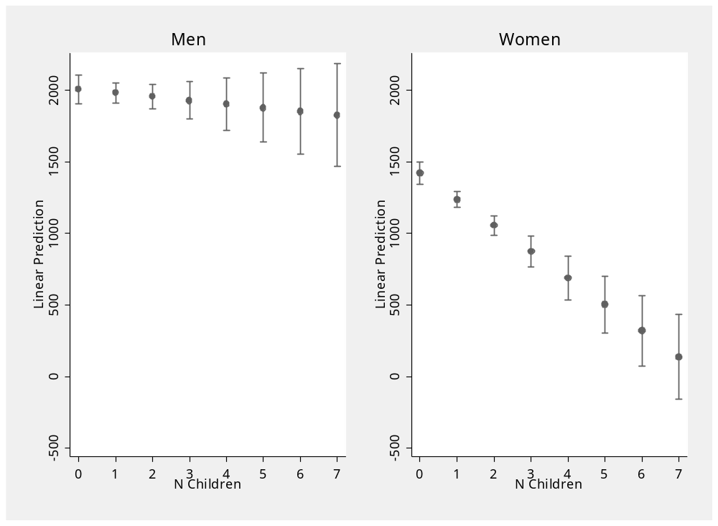
Graphs estimated with marginsplot (spost)

Slide 23
How else could we test the hypothesis that mothers pay a larger pay gap than women do?

Slide 24
Interaction terms-Binary
Y is a function of X
BUT think that (for now a binary variable) Z changes the effect of X

Slide 25
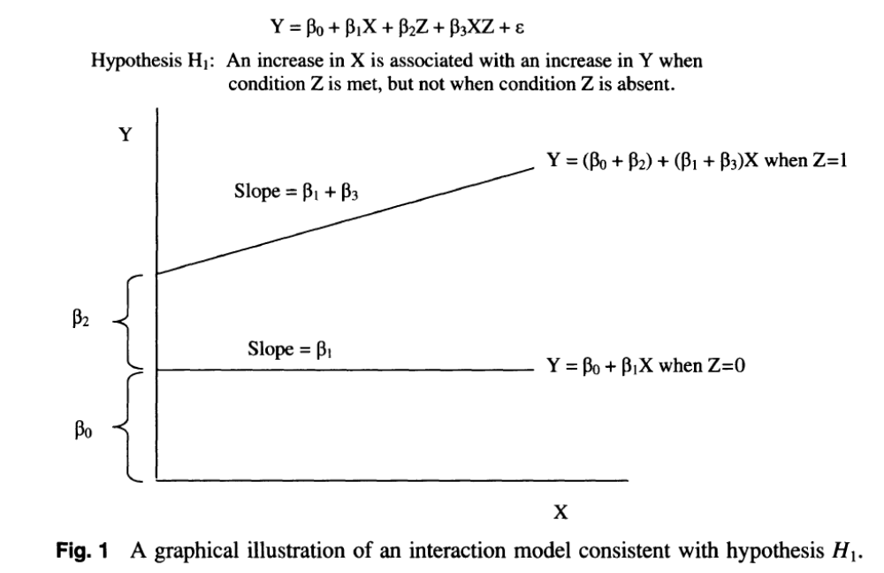
Interaction terms-Binary
Y=β₀+β₁X+ β₂Z+ β₃X*Z+ϵ
Predicted Y when Z=0
  Y=β₀+β₁X+ β₂(0)+ β₃X*(0)+ϵ
  Y=β₀+β₁X+ ϵ
Effect of X when Z=0
  β₁

Slide 26
Interaction terms-Binary
Y=β₀+β₁X+ β₂Z+ β₃X*Z+ϵ
Predicted Y when Z=1
  Y=β₀+β₁X+ β₂(1)+ β₃X*(1)+ϵ
  Y=β₀+β₁X + β₂+ β₃X+ϵ
Effect of X when Z=1
  β₁+ β₃

Slide 27
Interaction terms-Binary
Y=β₀+β₁X+ β₂Z+ β₃X*Z+ϵ
Effect of X when Z=0
  Β₁
Effect of X when Z=1
  β₁+ β₃
Does X have a significant effect?

Slide 28
Interaction terms-Binary
Y=β₀+β₁X+ β₂Z+ β₃X*Z+ϵ
Effect of X when Z=0
  Β₁
Effect of X when Z=1
  β₁+ β₃
Does X have a sig. effect?
  When Z=0, look at sig test of β₁
  When Z=1, must generate a sig. test of β₁+ β₃

Slide 29
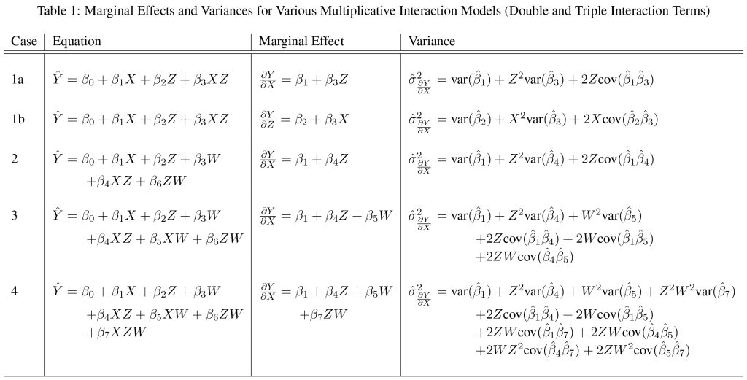


Reference equations to keep handy—need covariance matrix

Slide 30
Interaction terms-Binary
Y=β₀+β₁X+ β₂Z+ β₃X*Z+ϵ
Effect of X when z=0
  Β₁
Effect of X when z=1
  β₁+ β₃
Does X have a significant effect?
  When Z=1, need to generate a significance test of β₁+ β₃
  Var(β₁+ β₃)=Var(β₁)+Z²Var(β₃)+2ZCov(β₁+ β₃)

Slide 31
Interaction terms-Binary
Y=β₀+β₁X+ β₂Z+ β₃X*Z+ϵ
Effect of X when Z=0
  Β₁
Effect of X when Z=1
  β₁+ β₃
Does Z change the effect of X (is the effect of X different when Z=0 than when Z=1)?

Slide 32
Interaction terms-Binary
Y=β₀+β₁X+ β₂Z+ β₃X*Z+ϵ
Effect of X when z=0
  β₁
Effect of X when z=1
  β₁+ β₃
Does Z change the effect of X (is the effect of X different when Z=0 than when Z=1)?
  β₁=β₁+ β₃
  0=β₃ (i.e. is the interaction term statistically significant?)

Slide 33
Interaction terms-Binary
Y=β₀+β₁X+ β₂Z+ β₃X*Z+ϵ
Then what is β₂?

Slide 34
Interaction terms-Binary
Y=β₀+β₁X+ β₂Z+ β₃X*Z+ϵ
Then what is β₂?
  The effect of Z when X=0
What would be the effect of Z when X=1?

Slide 35
Interaction terms-Binary
Y=β₀+β₁X+ β₂Z+ β₃X*Z+ϵ
Then what is β₂?
  The effect of Z when X=0
What would be the effect of Z when X=1?
  β₂+ β₃*1

Slide 36
Interaction terms-Binary
Y=β₀+β₁X+ β₂Z+ β₃X*Z+ϵ
Then what is β₂?
  The effect of Z when X=0
What would be the effect of Z when X=2?
  β₂+ β₃

Slide 37
Interaction terms-Binary
Y=β₀+β₁X+ β₂Z+ β₃X*Z+ϵ
Then what is β₂?
  The effect of Z when X=0
What would be the effect of Z when X=2?
  β₂+ β₃*2

Slide 38
Apply to the previous example
. xi: reg gross_income_capped_10k i.female*education i.female*children_at_home
Source | SS df MS Number of obs = 5,665
-------------+---------------------------------- F(5, 5659) = 175.08
Model | 2.6673e+09 5 533451601 Prob > F = 0.0000
Residual | 1.7243e+10 5,659 3046968.54 R-squared = 0.1340
-------------+---------------------------------- Adj R-squared = 0.1332
Total | 1.9910e+10 5,664 3515192.97 Root MSE = 1745.6
----------------------------------------------------------------------------------
gross_income~10k | Coef. Std. Err. t P>|t| [95% Conf. Interval]
-----------------+----------------------------------------------------------------
_Ifemale_1 | -278.9598 109.4879 -2.55 0.011 -493.5981 -64.32152
education | 429.7862 20.86915 20.59 0.000 388.8746 470.6977
_IfemXeduca_1 | -122.0041 32.16628 -3.79 0.000 -185.0623 -58.94588
_Ifemale_1 | 0 (omitted)
children_at_home | -25.63498 26.94797 -0.95 0.342 -78.46334 27.19337
_IfemXchild_1 | -157.8532 41.66545 -3.79 0.000 -239.5334 -76.17292
_cons | 852.1683 71.53967 11.91 0.000 711.9232 992.4135
----------------------------------------------------------------------------------

Slide 39
Apply to the previous example
Xi: … (then) i.Female is how I get interaction terms for binary interactor
. xi: reg gross_income_capped_10k i.female*education i.female*children_at_home
Source | SS df MS Number of obs = 5,665
-------------+---------------------------------- F(5, 5659) = 175.08
Model | 2.6673e+09 5 533451601 Prob > F = 0.0000
Residual | 1.7243e+10 5,659 3046968.54 R-squared = 0.1340
-------------+---------------------------------- Adj R-squared = 0.1332
Total | 1.9910e+10 5,664 3515192.97 Root MSE = 1745.6
----------------------------------------------------------------------------------
gross_income~10k | Coef. Std. Err. t P>|t| [95% Conf. Interval]
-----------------+----------------------------------------------------------------
_Ifemale_1 | -278.9598 109.4879 -2.55 0.011 -493.5981 -64.32152
education | 429.7862 20.86915 20.59 0.000 388.8746 470.6977
_IfemXeduca_1 | -122.0041 32.16628 -3.79 0.000 -185.0623 -58.94588
_Ifemale_1 | 0 (omitted)
children_at_home | -25.63498 26.94797 -0.95 0.342 -78.46334 27.19337
_IfemXchild_1 | -157.8532 41.66545 -3.79 0.000 -239.5334 -76.17292
_cons | 852.1683 71.53967 11.91 0.000 711.9232 992.4135
----------------------------------------------------------------------------------

Slide 40
Apply to the previous example
. xi: reg gross_income_capped_10k i.female*education i.female*children_at_home
Source | SS df MS Number of obs = 5,665
-------------+---------------------------------- F(5, 5659) = 175.08
Model | 2.6673e+09 5 533451601 Prob > F = 0.0000
Residual | 1.7243e+10 5,659 3046968.54 R-squared = 0.1340
-------------+---------------------------------- Adj R-squared = 0.1332
Total | 1.9910e+10 5,664 3515192.97 Root MSE = 1745.6
----------------------------------------------------------------------------------
gross_income~10k | Coef. Std. Err. t P>|t| [95% Conf. Interval]
-----------------+----------------------------------------------------------------
_Ifemale_1 | -278.9598 109.4879 -2.55 0.011 -493.5981 -64.32152
education | 429.7862 20.86915 20.59 0.000 388.8746 470.6977
_IfemXeduca_1 | -122.0041 32.16628 -3.79 0.000 -185.0623 -58.94588
_Ifemale_1 | 0 (omitted)
children_at_home | -25.63498 26.94797 -0.95 0.342 -78.46334 27.19337
_IfemXchild_1 | -157.8532 41.66545 -3.79 0.000 -239.5334 -76.17292
_cons | 852.1683 71.53967 11.91 0.000 711.9232 992.4135
----------------------------------------------------------------------------------
How would we interpret each of these coefficients?

Slide 41
Compare the two methods
----------------------------
Female -279.0*
(-2.55)
Education 429.8***
(20.59)
Female*Education -122.0***
(-3.79)
N Children -25.63
(-0.95)
Female*Children -157.9***
(-3.79)
_cons 852.2***
(11.91)
----------------------------
N 5665
----------------------------
t statistics in parentheses
* p<0.05, ** p<0.01, *** p<0.001
 | Men | Women | Difference
Education | 429.800*** | 307.800*** | 122.000***
 | (23.850) | (19.290) | (30.675)
N Children | -25.630 | -183.500*** | 157.870***
 | (30.800) | (25.040) | (39.694)
Constant | 852.200*** | 573.200*** | 279.000**
 | (81.750) | (65.320) | (104.641)
Observations | 3134 | 2531
See any similarities?
(Specifically can you find all the coefficients from the left model in the right ones?)

Slide 42
Compare the two methods
----------------------------
Female -279.0*
(-2.55)
Education 429.8***
(20.59)
Female*Education -122.0***
(-3.79)
N Children -25.63
(-0.95)
Female*Children -157.9***
(-3.79)
_cons 852.2***
(11.91)
----------------------------
N 5665
----------------------------
t statistics in parentheses
* p<0.05, ** p<0.01, *** p<0.001
 | Men | Women | Difference
Education | 429.800*** | 307.800*** | 122.000***
 | (23.850) | (19.290) | (30.675)
N Children | -25.630 | -183.500*** | 157.870***
 | (30.800) | (25.040) | (39.694)
Constant | 852.200*** | 573.200*** | 279.000**
 | (81.750) | (65.320) | (104.641)
Observations | 3134 | 2531
What can we not get from the left model that we can in the right?
(sorry that I generated the t and not the se on the left)

Slide 43
Compare the two methods
----------------------------
Female -279.0*
(-2.55)
Education 429.8***
(20.59)
Female*Education -122.0***
(-3.79)
N Children -25.63
(-0.95)
Female*Children -157.9***
(-3.79)
_cons 852.2***
(11.91)
----------------------------
N 5665
----------------------------
t statistics in parentheses
* p<0.05, ** p<0.01, *** p<0.001
Does having children have a significant effect on females’ salaries?
  (we know from the split sample that it does)
Know coefficient is -183.53
  (i.e., -157.90 + -25.63)
But is that significant?

Slide 44
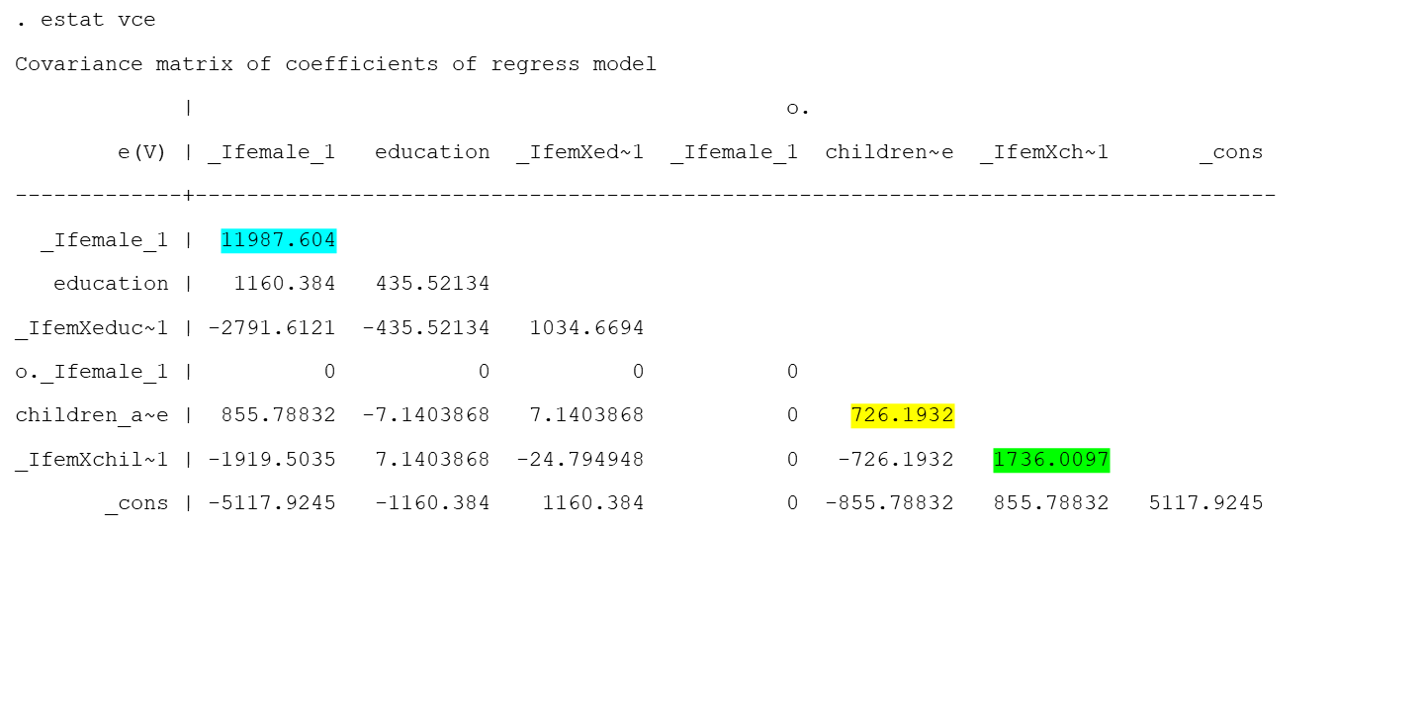
Getting standard errors
Var(β₁+ β₃)= Var(β₁)+Z²Var(β₃) +2ZCov(β₁+ β₃)
Estat vce→
Var(β₁+ β₃)= 726.1932+1²*11987.604 +2*1*1736.0097
Var(β₁+ β₃)=10009.817
Se(β₁+ β₃)= 31

Slide 45
Getting standard errors
Se(β₁+ β₃)= 31
T= -183.53 /31
  Is plenty significant
. estat vce
Covariance matrix of coefficients of regress model
| o.
e(V) | _Ifemale_1 education _IfemXed~1 _Ifemale_1 children~e _IfemXch~1 _cons
-------------+------------------------------------------------------------------------------------
_Ifemale_1 | 11987.604
education | 1160.384 435.52134
_IfemXeduc~1 | -2791.6121 -435.52134 1034.6694
o._Ifemale_1 | 0 0 0 0
children_a~e | 855.78832 -7.1403868 7.1403868 0 726.1932
_IfemXchil~1 | -1919.5035 7.1403868 -24.794948 0 -726.1932 1736.0097
_cons | -5117.9245 -1160.384 1160.384 0 -855.78832 855.78832 5117.9245

Slide 46
Advantages of interaction terms
Direct tests of whether the groups are different and the effect varies across groups
All the variables do not have to vary across groups like split samples do

Slide 47
Disadvantages of interaction terms
Cannot get direct estimate of the new coefficient from them
Take more work to interpret and present
  Especially as get more complicated

Slide 48
Best Way to Present:
GRAPHS!!!!!
Everything you need to know is on Golder’s website: http://mattgolder.com/interactions
Or can do it by hand like I often do

Slide 49
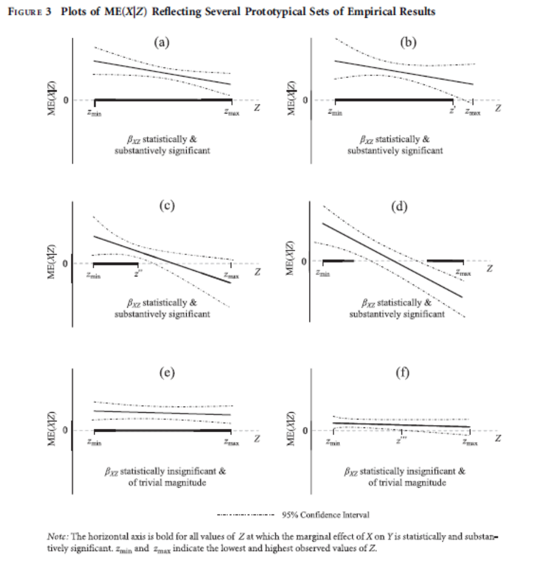

Slide 50
OK, now let’s assume that X and Z are both continuous

Slide 51
Interaction terms-Continuous
Y=β₀+β₁X+ β₂Z+ β₃X*Z+ϵ
Predicted Y when z=0
  Y=β₀+β₁X+ β₂(0)+ β₃X*(0)+ϵ
  Y=β₀+β₁X+ ϵ
Effect of X when z=0
  β₁

Slide 52
Interaction terms-Continuous
Y=β₀+β₁X+ β₂Z+ β₃X*Z+ϵ
Predicted Y when z≠0
  Y=β₀+β₁X+ β₂(Z)+ β₃X*(Z)+ϵ
Effect of X when z=1
  β₁+ β₃Z

Slide 53
Interaction terms-Continuous
Y=β₀+β₁X+ β₂Z+ β₃X*Z+ϵ
Effect of X when z=0
  Β₁
Effect of X when z≠0
  β₁+ β₃Z
Does X have a significant effect?

Slide 54
Interaction terms-Continuous
Y=β₀+β₁X+ β₂Z+ β₃X*Z+ϵ
Effect of X when z=0
  Β₁
Effect of X when z≠0
  β₁+ β₃Z
Does X have a significant effect?
  When Z=0, look at significance test of Β₁
  When z≠0, need to generate a significance test of β₁+ β₃Z

Slide 55
Interaction terms-Continuous
Y=β₀+β₁X+ β₂Z+ β₃X*Z+ϵ
Effect of X when z=1
  β₁+ β₃
Does X have a significant effect?
  When Z=1, need to generate a significance test of β₁+ β₃Z
  That estimate will vary by Z
  Var(β₁+ β₃)=Var(β₁)+Z²Var(β₃)+2ZCov(β₁+ β₃)

Slide 56
Example
Use a subset of the data from Singer’s 2008 paper on Duverger
District level electoral fragmentation data
Ivs:
  Ln(m): logged district magnitude
  New democracy (dummy variable)
  Effective number of ethnic groups
Multi-level model

Slide 57
-----------------------------------------------------------------------------------
enpv | Coef. Std. Err. z P>|z| [95% Conf. Interval]
------------------+----------------------------------------------------------------
ln_DstMag | .436064 .1416352 3.08 0.002 .158464 .7136639
ethgrps| -1.583568 .8960135 -1.77 0.077 -3.339722 .1725861
|
ln_DstMag*ethgrps | 1.234343 .3360047 3.67 0.000 .5757857 1.8929
|
ln_DstMag | 0 (omitted)
newdem | 1.686124 .6540795 2.58 0.010 .404152 2.968097
|
ln_DstMag*newdem | -.8636402 .2168432 -3.98 0.000 -1.288645 -.4386353
|
png | 11.04205 1.453306 7.60 0.000 8.193625 13.89048
_cons | 3.319324 .4426837 7.50 0.000 2.45168 4.186968
-----------------------------------------------------------------------------------
------------------------------------------------------------------------------
Random-effects Parameters | Estimate Std. Err. [95% Conf. Interval]
-----------------------------+------------------------------------------------
country: Identity |
var(_cons) | 1.760319 .3964034 1.132168 2.736983
-----------------------------+------------------------------------------------
var(Residual) | 2.179275 .0510529 2.081476 2.28167
------------------------------------------------------------------------------
What does this coefficient mean?

Slide 58
-----------------------------------------------------------------------------------
enpv | Coef. Std. Err. z P>|z| [95% Conf. Interval]
------------------+----------------------------------------------------------------
ln_DstMag | .436064 .1416352 3.08 0.002 .158464 .7136639
ethgrps| -1.583568 .8960135 -1.77 0.077 -3.339722 .1725861
|
ln_DstMag*ethgrps | 1.234343 .3360047 3.67 0.000 .5757857 1.8929
|
ln_DstMag | 0 (omitted)
newdem | 1.686124 .6540795 2.58 0.010 .404152 2.968097
|
ln_DstMag*newdem | -.8636402 .2168432 -3.98 0.000 -1.288645 -.4386353
|
png | 11.04205 1.453306 7.60 0.000 8.193625 13.89048
_cons | 3.319324 .4426837 7.50 0.000 2.45168 4.186968
-----------------------------------------------------------------------------------
------------------------------------------------------------------------------
Random-effects Parameters | Estimate Std. Err. [95% Conf. Interval]
-----------------------------+------------------------------------------------
country: Identity |
var(_cons) | 1.760319 .3964034 1.132168 2.736983
-----------------------------+------------------------------------------------
var(Residual) | 2.179275 .0510529 2.081476 2.28167
------------------------------------------------------------------------------
This is the effect of adding seats when (1) ethnic fragmentation =0 and (2) it is NOT a new democracy

Slide 59
-----------------------------------------------------------------------------------
enpv | Coef. Std. Err. z P>|z| [95% Conf. Interval]
------------------+----------------------------------------------------------------
ln_DstMag | .436064 .1416352 3.08 0.002 .158464 .7136639
ethgrps| -1.583568 .8960135 -1.77 0.077 -3.339722 .1725861
|
ln_DstMag*ethgrps | 1.234343 .3360047 3.67 0.000 .5757857 1.8929
|
ln_DstMag | 0 (omitted)
newdem | 1.686124 .6540795 2.58 0.010 .404152 2.968097
|
ln_DstMag*newdem | -.8636402 .2168432 -3.98 0.000 -1.288645 -.4386353
|
png | 11.04205 1.453306 7.60 0.000 8.193625 13.89048
_cons | 3.319324 .4426837 7.50 0.000 2.45168 4.186968
-----------------------------------------------------------------------------------
------------------------------------------------------------------------------
Random-effects Parameters | Estimate Std. Err. [95% Conf. Interval]
-----------------------------+------------------------------------------------
country: Identity |
var(_cons) | 1.760319 .3964034 1.132168 2.736983
-----------------------------+------------------------------------------------
var(Residual) | 2.179275 .0510529 2.081476 2.28167
------------------------------------------------------------------------------
Note: is Positive and significant, but ONLY for that combination

Slide 60
-----------------------------------------------------------------------------------
enpv | Coef. Std. Err. z P>|z| [95% Conf. Interval]
------------------+----------------------------------------------------------------
ln_DstMag | .436064 .1416352 3.08 0.002 .158464 .7136639
ethgrps| -1.583568 .8960135 -1.77 0.077 -3.339722 .1725861
|
ln_DstMag*ethgrps | 1.234343 .3360047 3.67 0.000 .5757857 1.8929
|
ln_DstMag | 0 (omitted)
newdem | 1.686124 .6540795 2.58 0.010 .404152 2.968097
|
ln_DstMag*newdem | -.8636402 .2168432 -3.98 0.000 -1.288645 -.4386353
|
png | 11.04205 1.453306 7.60 0.000 8.193625 13.89048
_cons | 3.319324 .4426837 7.50 0.000 2.45168 4.186968
-----------------------------------------------------------------------------------
------------------------------------------------------------------------------
Random-effects Parameters | Estimate Std. Err. [95% Conf. Interval]
-----------------------------+------------------------------------------------
country: Identity |
var(_cons) | 1.760319 .3964034 1.132168 2.736983
-----------------------------+------------------------------------------------
var(Residual) | 2.179275 .0510529 2.081476 2.28167
------------------------------------------------------------------------------
What does this coefficient mean?

Slide 61
-----------------------------------------------------------------------------------
enpv | Coef. Std. Err. z P>|z| [95% Conf. Interval]
------------------+----------------------------------------------------------------
ln_DstMag | .436064 .1416352 3.08 0.002 .158464 .7136639
ethgrps| -1.583568 .8960135 -1.77 0.077 -3.339722 .1725861
|
ln_DstMag*ethgrps | 1.234343 .3360047 3.67 0.000 .5757857 1.8929
|
ln_DstMag | 0 (omitted)
newdem | 1.686124 .6540795 2.58 0.010 .404152 2.968097
|
ln_DstMag*newdem | -.8636402 .2168432 -3.98 0.000 -1.288645 -.4386353
|
png | 11.04205 1.453306 7.60 0.000 8.193625 13.89048
_cons | 3.319324 .4426837 7.50 0.000 2.45168 4.186968
-----------------------------------------------------------------------------------
------------------------------------------------------------------------------
Random-effects Parameters | Estimate Std. Err. [95% Conf. Interval]
-----------------------------+------------------------------------------------
country: Identity |
var(_cons) | 1.760319 .3964034 1.132168 2.736983
-----------------------------+------------------------------------------------
var(Residual) | 2.179275 .0510529 2.081476 2.28167
------------------------------------------------------------------------------
Is the effect of ethnicity when ln.DstMag =0 [i.e. when m=1]. Which is not significant

Slide 62
-----------------------------------------------------------------------------------
enpv | Coef. Std. Err. z P>|z| [95% Conf. Interval]
------------------+----------------------------------------------------------------
ln_DstMag | .436064 .1416352 3.08 0.002 .158464 .7136639
ethgrps| -1.583568 .8960135 -1.77 0.077 -3.339722 .1725861
|
ln_DstMag*ethgrps | 1.234343 .3360047 3.67 0.000 .5757857 1.8929
|
ln_DstMag | 0 (omitted)
newdem | 1.686124 .6540795 2.58 0.010 .404152 2.968097
|
ln_DstMag*newdem | -.8636402 .2168432 -3.98 0.000 -1.288645 -.4386353
|
png | 11.04205 1.453306 7.60 0.000 8.193625 13.89048
_cons | 3.319324 .4426837 7.50 0.000 2.45168 4.186968
-----------------------------------------------------------------------------------
------------------------------------------------------------------------------
Random-effects Parameters | Estimate Std. Err. [95% Conf. Interval]
-----------------------------+------------------------------------------------
country: Identity |
var(_cons) | 1.760319 .3964034 1.132168 2.736983
-----------------------------+------------------------------------------------
var(Residual) | 2.179275 .0510529 2.081476 2.28167
------------------------------------------------------------------------------
What does this coefficient mean?

Slide 63
-----------------------------------------------------------------------------------
enpv | Coef. Std. Err. z P>|z| [95% Conf. Interval]
------------------+----------------------------------------------------------------
ln_DstMag | .436064 .1416352 3.08 0.002 .158464 .7136639
ethgrps| -1.583568 .8960135 -1.77 0.077 -3.339722 .1725861
|
ln_DstMag*ethgrps | 1.234343 .3360047 3.67 0.000 .5757857 1.8929
|
ln_DstMag | 0 (omitted)
newdem | 1.686124 .6540795 2.58 0.010 .404152 2.968097
|
ln_DstMag*newdem | -.8636402 .2168432 -3.98 0.000 -1.288645 -.4386353
|
png | 11.04205 1.453306 7.60 0.000 8.193625 13.89048
_cons | 3.319324 .4426837 7.50 0.000 2.45168 4.186968
-----------------------------------------------------------------------------------
------------------------------------------------------------------------------
Random-effects Parameters | Estimate Std. Err. [95% Conf. Interval]
-----------------------------+------------------------------------------------
country: Identity |
var(_cons) | 1.760319 .3964034 1.132168 2.736983
-----------------------------+------------------------------------------------
var(Residual) | 2.179275 .0510529 2.081476 2.28167
------------------------------------------------------------------------------
How does ethnicity change the effect of district magnitude?

Slide 64
-----------------------------------------------------------------------------------
enpv | Coef. Std. Err. z P>|z| [95% Conf. Interval]
------------------+----------------------------------------------------------------
ln_DstMag | .436064 .1416352 3.08 0.002 .158464 .7136639
ethgrps| -1.583568 .8960135 -1.77 0.077 -3.339722 .1725861
|
ln_DstMag*ethgrps | 1.234343 .3360047 3.67 0.000 .5757857 1.8929
|
ln_DstMag | 0 (omitted)
newdem | 1.686124 .6540795 2.58 0.010 .404152 2.968097
|
ln_DstMag*newdem | -.8636402 .2168432 -3.98 0.000 -1.288645 -.4386353
|
png | 11.04205 1.453306 7.60 0.000 8.193625 13.89048
_cons | 3.319324 .4426837 7.50 0.000 2.45168 4.186968
-----------------------------------------------------------------------------------
------------------------------------------------------------------------------
Random-effects Parameters | Estimate Std. Err. [95% Conf. Interval]
-----------------------------+------------------------------------------------
country: Identity |
var(_cons) | 1.760319 .3964034 1.132168 2.736983
-----------------------------+------------------------------------------------
var(Residual) | 2.179275 .0510529 2.081476 2.28167
------------------------------------------------------------------------------
How does district magnitude change the effect of ethnicity?

Slide 65
-----------------------------------------------------------------------------------
enpv | Coef. Std. Err. z P>|z| [95% Conf. Interval]
------------------+----------------------------------------------------------------
ln_DstMag | .436064 .1416352 3.08 0.002 .158464 .7136639
ethgrps| -1.583568 .8960135 -1.77 0.077 -3.339722 .1725861
|
ln_DstMag*ethgrps | 1.234343 .3360047 3.67 0.000 .5757857 1.8929
|
ln_DstMag | 0 (omitted)
newdem | 1.686124 .6540795 2.58 0.010 .404152 2.968097
|
ln_DstMag*newdem | -.8636402 .2168432 -3.98 0.000 -1.288645 -.4386353
|
png | 11.04205 1.453306 7.60 0.000 8.193625 13.89048
_cons | 3.319324 .4426837 7.50 0.000 2.45168 4.186968
-----------------------------------------------------------------------------------
------------------------------------------------------------------------------
Random-effects Parameters | Estimate Std. Err. [95% Conf. Interval]
-----------------------------+------------------------------------------------
country: Identity |
var(_cons) | 1.760319 .3964034 1.132168 2.736983
-----------------------------+------------------------------------------------
var(Residual) | 2.179275 .0510529 2.081476 2.28167
------------------------------------------------------------------------------
NOTE-THESE INTERACTION TERMS CAN BE INTERPRETED AS EITHER THE EFFECT OF Z ON X OR VICE VERSA

Slide 66
-----------------------------------------------------------------------------------
enpv | Coef. Std. Err. z P>|z| [95% Conf. Interval]
------------------+----------------------------------------------------------------
ln_DstMag | .436064 .1416352 3.08 0.002 .158464 .7136639
ethgrps| -1.583568 .8960135 -1.77 0.077 -3.339722 .1725861
|
ln_DstMag*ethgrps | 1.234343 .3360047 3.67 0.000 .5757857 1.8929
|
ln_DstMag | 0 (omitted)
newdem | 1.686124 .6540795 2.58 0.010 .404152 2.968097
|
ln_DstMag*newdem | -.8636402 .2168432 -3.98 0.000 -1.288645 -.4386353
|
png | 11.04205 1.453306 7.60 0.000 8.193625 13.89048
_cons | 3.319324 .4426837 7.50 0.000 2.45168 4.186968
-----------------------------------------------------------------------------------
------------------------------------------------------------------------------
Random-effects Parameters | Estimate Std. Err. [95% Conf. Interval]
-----------------------------+------------------------------------------------
country: Identity |
var(_cons) | 1.760319 .3964034 1.132168 2.736983
-----------------------------+------------------------------------------------
var(Residual) | 2.179275 .0510529 2.081476 2.28167
------------------------------------------------------------------------------
In either case, the combination leads to more parties

Slide 67
-----------------------------------------------------------------------------------
enpv | Coef. Std. Err. z P>|z| [95% Conf. Interval]
------------------+----------------------------------------------------------------
ln_DstMag | .436064 .1416352 3.08 0.002 .158464 .7136639
ethgrps| -1.583568 .8960135 -1.77 0.077 -3.339722 .1725861
|
ln_DstMag*ethgrps | 1.234343 .3360047 3.67 0.000 .5757857 1.8929
|
ln_DstMag | 0 (omitted)
newdem | 1.686124 .6540795 2.58 0.010 .404152 2.968097
|
ln_DstMag*newdem | -.8636402 .2168432 -3.98 0.000 -1.288645 -.4386353
|
png | 11.04205 1.453306 7.60 0.000 8.193625 13.89048
_cons | 3.319324 .4426837 7.50 0.000 2.45168 4.186968
-----------------------------------------------------------------------------------
------------------------------------------------------------------------------
Random-effects Parameters | Estimate Std. Err. [95% Conf. Interval]
-----------------------------+------------------------------------------------
country: Identity |
var(_cons) | 1.760319 .3964034 1.132168 2.736983
-----------------------------+------------------------------------------------
var(Residual) | 2.179275 .0510529 2.081476 2.28167
------------------------------------------------------------------------------
New democracies have more parties than old democracies WHEN THE LN(DISTRICT MAGNITUDE) EQUALS 0

Slide 68
-----------------------------------------------------------------------------------
enpv | Coef. Std. Err. z P>|z| [95% Conf. Interval]
------------------+----------------------------------------------------------------
ln_DstMag | .436064 .1416352 3.08 0.002 .158464 .7136639
ethgrps| -1.583568 .8960135 -1.77 0.077 -3.339722 .1725861
|
ln_DstMag*ethgrps | 1.234343 .3360047 3.67 0.000 .5757857 1.8929
|
ln_DstMag | 0 (omitted)
newdem | 1.686124 .6540795 2.58 0.010 .404152 2.968097
|
ln_DstMag*newdem | -.8636402 .2168432 -3.98 0.000 -1.288645 -.4386353
|
png | 11.04205 1.453306 7.60 0.000 8.193625 13.89048
_cons | 3.319324 .4426837 7.50 0.000 2.45168 4.186968
-----------------------------------------------------------------------------------
------------------------------------------------------------------------------
Random-effects Parameters | Estimate Std. Err. [95% Conf. Interval]
-----------------------------+------------------------------------------------
country: Identity |
var(_cons) | 1.760319 .3964034 1.132168 2.736983
-----------------------------+------------------------------------------------
var(Residual) | 2.179275 .0510529 2.081476 2.28167
------------------------------------------------------------------------------
Adding seats does not make more electoral fragmentation

Slide 69
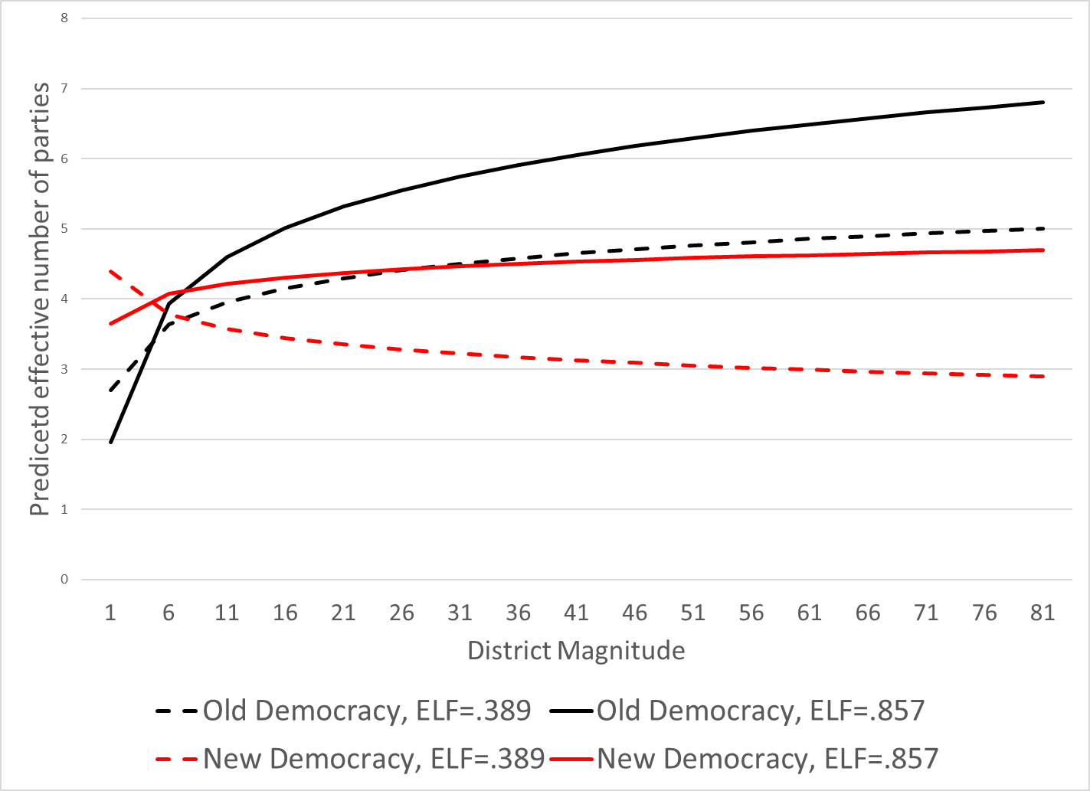
Simple (or Simplish) Graph to Illustrate
Missing C.I.’s
Histogram (?)

Slide 70
Getting REALLY Complicated
What if there are multiple variables that interact? Forthcoming PRSM
Frame/RQ:
  Growth should help the incumbent… But what if not everyone benefits from it?
Theory:
  Inequality changes the distribution of growth
  Certain parties should benefit from that distribution
    Left (should) benefit from pro-poor growth
    Right (should) benefit from pro-rich growth
Design: TSCS data

Slide 71
Table 1: The Conditional Effects of Growth on Approval
DV: Presidential Approval | I | II# | III## | IV | V# | VI## | VII
Growth | 0.215* | 0.410* | 0.0578 | -1.552† | 4.729*** | -4.678*** | 4.008**
 | 0.097 | 0.108 | 0.135 | 0.853 | 1.272 | 1.081 | 1.716
Inequality | -0.409 | -0.357 | -0.706 | -0.445 | -0.128 | -0.849* | -0.764**
 | 0.316 | 0.428 | 0.464 | 0.316 | 0.427 | 0.457 | 0.381
Right President | -1.335 |  |  | -1.364 |  |  | -23.45
 | 1.526 |  |  | 1.53 |  |  | 16.86
Growth×Inequality |  |  |  | 0.039** | -0.100*** | 0.101*** | -0.0820**
 |  |  |  | 0.019 | 0.029 | 0.023 | 0.039
Growth×Right President |  |  |  |  |  |  | -8.526***
 |  |  |  |  |  |  | 1.954
Inequality×Right President |  |  |  |  |  |  | 0.457
 |  |  |  |  |  |  | 0.365
Growth×Inequality×Right President |  |  |  |  |  |  | 0.180***
 |  |  |  |  |  |  | 0.0439
ln(inflation) | -1.816*** | -5.338*** | -1.529*** | -5.658*** | -5.361*** | -1.554*** | -1.912***
 | 0.461 | 0.77 | 0.569 | 0.754 | 0.749 | 0.538 | 0.445
New President | 6.128*** | 5.478*** | 6.116*** | 7.069*** | 6.882*** | 6.332*** | 6.286***
 | 0.607 | 1.002 | 0.764 | 1.127 | 1.113 | 0.761 | 0.604
New President_{t-1} | 6.599*** | 5.478*** | 6.755*** | 6.657*** | 6.425*** | 7.022*** | 6.789***
 | 0.643 | 0.899 | 0.798 | 0.941 | 0.929 | 0.795 | 0.639
New President_{t-2} | 2.776*** | 2.080*** | 2.769*** | 2.905*** | 2.764*** | 2.962*** | 2.907***
 | 0.539 | 0.757 | 0.66 | 0.792 | 0.782 | 0.659 | 0.537
Scandal | -0.827 | 0.0240 | -1.293* | 0.505 | 0.352 | -1.317* | -0.835
 | 0.579 | 0.759 | 0.726 | 0.79 | 0.781 | 0.729 | 0.58
Scandal_{t-1} | -0.745 | -0.362 | -1.189 | -0.0111 | -0.159 | -1.191 | -0.742
 | 0.586 | 0.766 | 0.733 | 0.808 | 0.798 | 0.736 | 0.586
Constant | 87.71*** | 22.51 | 92.92*** | 63.59*** | 51.33** | 102.8*** | 110.3***
 | 14.19 | 17.84 | 20.09 | 20 | 20.04 | 19.65 | 17.72
Observations | 1,504 | 406 | 1,098 | 406 | 406 | 1,098 | 1,504
Number of Countries | 18 | 14 | 18 | 14 | 14 | 18 | 18
R² | 0.704 | 0.930 | 0.696 | 0.914 | 0.919 | 0.692 | 0.713
# Left Presidents Only; ## Right Presidents Only †p<.1,*p<.05 2-tailed
There are a lot of moving parts here
We use some split sample estimations because we have found that reviewers don’t like triple interaction terms
Note because we don’t interact all the variables in model 7, the split sample and interaction terms don’t align like they did in the first example
But can you explain to me what the first 7 variables capture in model 7?
  i.e. “Growth”: the effect of growth when inequality equals 0 and when the president is from the left (right president=0)

Slide 72
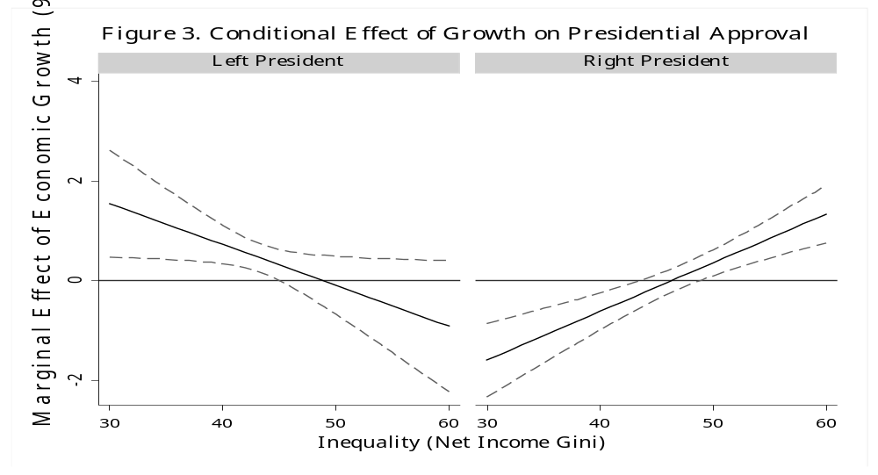
Using a graph to illustrate the effects
(Calculating the standard errors is “fun”)

Slide 73
Some Things to Avoid
Not including all the constituent terms (See Golder)
Looking at split samples without looking at the difference

Slide 74
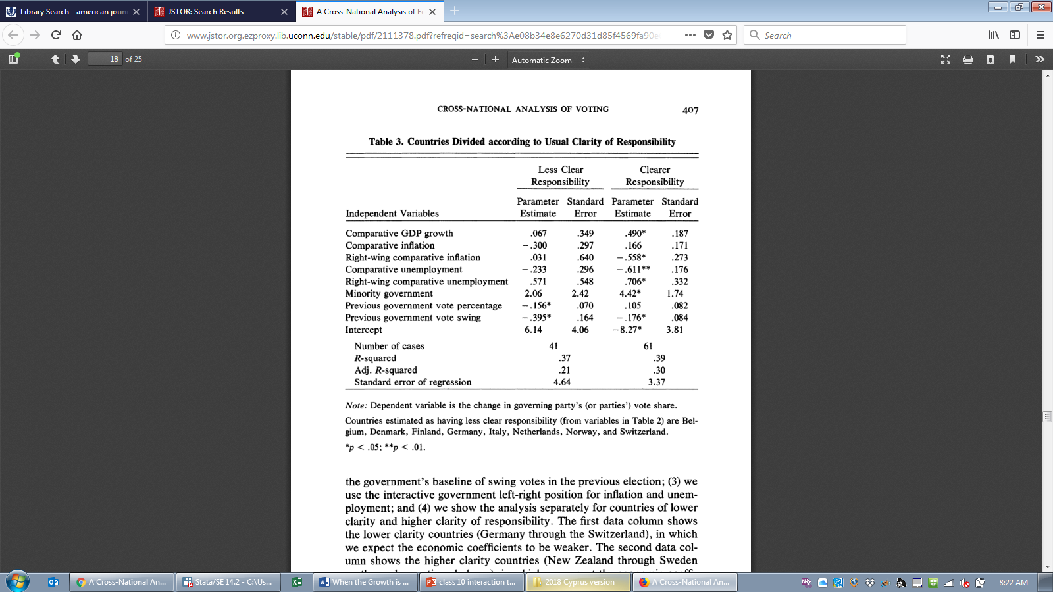

Slide 75
difference | se | t
0.423 | 0.396 | 1.068
0.466 | 0.343 | 1.360
-0.589 | 0.696 | -0.847
-0.378 | 0.344 | -1.098
0.135 | 0.641 | 0.211

Slide 76
Some Things to Avoid
Not including all the constituent terms (See Golder)
Looking at split samples without looking at the difference
Today’s equivalent: Looking only at the “Golder effect graphs” that find a range of Z where X is significant but where x*z is not significant

Slide 77
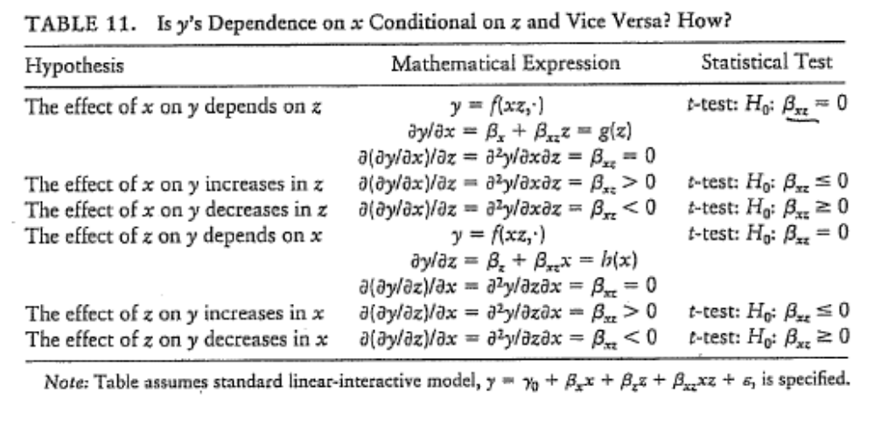
Don’t forget (Kam and Franzese p.50)

Slide 78
Some Things to Avoid
Not including all the constituent terms (See Golder)
Looking at split samples without looking at the difference
Today’s equivalent: Looking only at the “Golder effect graphs” that find a range of Z where X is significant but where x*z is not significant
Fishing for the “right” interaction term (I am a bit worried we are doing that on my paper)

